Slide 1

Presentation
in the discipline:
English for professional purposes
on the topic:
Unusual jobs
first-year master's student of group PM-24-1
Movsisyan Laura Rostomivna

Slide 2



Nursery Manager
Role and Responsibilities
Notes:
Slide 1: Overview of a Nursery Manager
£32,996 Average base salary
Title: Nursery Manager: Role and Responsibilities
Introduction:
A Nursery Manager oversees the daily operations of a nursery or childcare center.
Ensures a safe, nurturing, and educational environment for young children.
Key Responsibilities:
Curriculum Development: Plan and implement educational activities to stimulate children’s intellectual, physical, and social growth.
Staff Management: Recruit, hire, train, and supervise nursery staff.
Health and Safety: Ensure compliance with health and safety regulations.
Parent Communication: Regularly update parents on their child’s progress and address any concerns.
Budget Management: Manage budgets and ensure resources are well-stocked and of high quality.

Slide 3


Nursery Manager
Work Settings

Slide 4
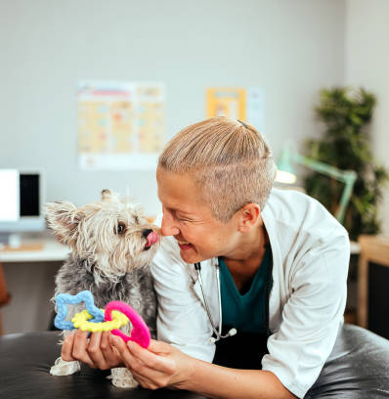


Pet psychologist
Role and Responsibilities
Notes:
Slide 1: Overview of a Pet Psychologist
Earning potential: $52,000
Title: Pet Psychologist: Role and Responsibilities
Content:
Introduction:
A Pet Psychologist works with animals to address behavioral issues and improve their well-being.
They help pets and their owners understand and resolve problems such as anxiety, aggression, and stress.
Key Responsibilities:
Behavioral Assessment: Evaluate pets to identify behavioral issues and their causes.
Treatment Plans: Develop and implement strategies to modify undesirable behaviors.
Owner Education: Teach pet owners how to manage and improve their pets’ behavior.
Collaboration: Work with veterinarians and other professionals to ensure comprehensive care.
Research: Study animal behavior to develop new treatment methods and improve existing ones.

Slide 5
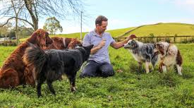
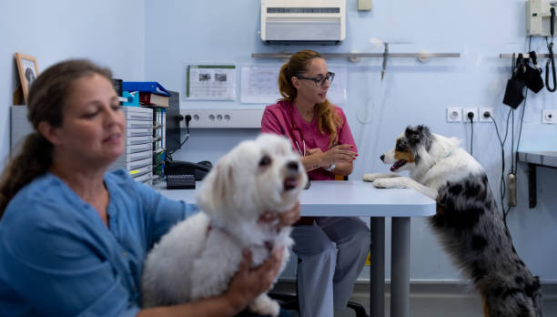
Pet psychologist
Work Settings
Notes:
Work Settings:
Private Practice: Offering consultations and therapy sessions for pets and their owners.
Veterinary Clinics: Collaborating with veterinarians to provide comprehensive care.
Animal Shelters: Helping shelter animals adjust and become more adoptable.
Zoos and Aquariums: Working with a variety of species to ensure their mental well-being.
Skills Required:
Empathy and Patience: Essential for working with both animals and their owners.
Analytical Skills: Important for diagnosing behavioral issues and developing effective treatment plans.
Communication Skills: Necessary for educating pet owners and collaborating with other professionals.
Educational Path:
Degree in Psychology or Animal Behavior: A bachelor’s degree is typically required, with advanced degrees (master’s or doctorate) preferred for specialized roles.
Certifications: Additional certifications in animal behavior or related fields can enhance career prospects.

Slide 6



Dog Food Taster
Role and Responsibilities
Notes:
Dog Food Taster
Earning potential: $45,000 per year
Role Overview: A Dog Food Taster plays a unique role in the pet food industry by evaluating the taste, texture, and smell of dog food to ensure it meets quality and flavor standards. This job helps ensure that pet food is both nutritious and appealing to dogs.
Key Responsibilities:
Taste Testing: Sampling dog food to assess its flavor, texture, and smell. While they don’t swallow the food, they provide detailed feedback on its palatability.
Quality Assurance: Ensuring that the dog food meets nutritional standards and is safe for consumption.
Product Development: Collaborating with veterinarians, nutritionists, and product developers to improve existing products and develop new ones.
Documentation: Recording observations and feedback to help refine and enhance pet food products.
Research: Staying informed about the latest trends and research in pet nutrition to ensure the products are up-to-date and competitive.

Slide 7



Dog Food Taster
Work Settings
Notes:
Work Settings:
Pet Food Companies: Working in laboratories or production facilities to test and develop pet food products.
Research Institutions: Participating in studies related to pet nutrition and food safety.
Skills Required:
Keen Sense of Taste and Smell: Essential for accurately evaluating the flavor and aroma of dog food.
Attention to Detail: Important for identifying subtle differences in taste and texture.
Communication Skills: Necessary for providing clear and detailed feedback to the development team.
Passion for Pets: A genuine interest in animal health and nutrition.
Educational Path:
Degree in Food Science or Nutrition: A bachelor’s degree is typically required, with advanced degrees beneficial for specialized roles.
Experience in the Food Industry: Previous experience in food tasting or quality assurance can be advantageous.

Slide 8

IN BRIEF
In conclusion, exploring unusual jobs like Nursery Manager, Pet Psychologist, and Dog Food Tester reveals the fascinating diversity in career paths available today. These roles, while unconventional, highlight the unique skills and passions that drive individuals to pursue them.
Nursery Managers play a crucial role in nurturing young plants, ensuring they grow healthy and strong, which is vital for our environment and agriculture. Pet Psychologists provide invaluable insights into animal behavior, helping pets and their owners live harmoniously. Meanwhile, Dog Food Testers ensure the quality and safety of pet food, contributing to the well-being of our furry friends.
These careers remind us that the job market is full of opportunities beyond the traditional paths. They encourage us to think creatively about our own career choices and to appreciate the diverse ways people contribute to society. Embracing these unique professions can lead to fulfilling and impactful careers.
Thank you for your attention, and I hope this presentation has inspired you to consider the endless possibilities in the world of work.
Notes:
Exploring unconventional careers like Pet Psychologist, Nursery Manager, and Dog Food Taster reveals the diverse opportunities available in the job market. These roles highlight the importance of specialized skills and passion in fields that may not be widely recognized but are crucial for animal welfare, plant cultivation, and pet nutrition. Each job offers unique challenges and rewards, demonstrating that following one’s interests can lead to fulfilling and impactful careers. Embracing these unusual professions can pave the way for innovation and excellence in their respective industries.

